Slide 1


電信工程股份有限公司
Carbon emissions report
31 OCT , 2024

Slide 2

Committed to Act
Gau Shyang
高祥電信
1
[Gau Shyang Telecommunication Engineering Co] Commits to the 1,5 °C Climate Ambition
Gau Shyang Telecommunication commits to the 1.5°C Climate Ambition and pledges to:
Definition of Net-Zero
Reduction of emissions in value chain in line with the 1.5°C pathway
Neutralize the consequences of any remaining emissions by permanently eliminating an equivalent volume of CO2 (SBTi, 2021)
We commit to the 1,5°C Climate Ambition and pledges to reduce CO2 emissions.
We set the plan of net-zero carbon emission according to SBTi 1.5°C targets
From Y2024 to Y2030, the annual reduction goal is 8.3% (50% by 6 Years) for every year.
From Y2030 to Y2050, the annual reduction goal is 2.5% (50% by 20 Years) for every year and achieve Net-Zero in Y2050
Holds Oath Taking Ceremony of [Gau Shyang Telecommunication Engineering Co] Senior Executives Committee to promise and show our determination to achieve the targets on behalf of all colleagues.
Halve absolute emissions by 2030 and
reach Net-Zero by 2050

Slide 3
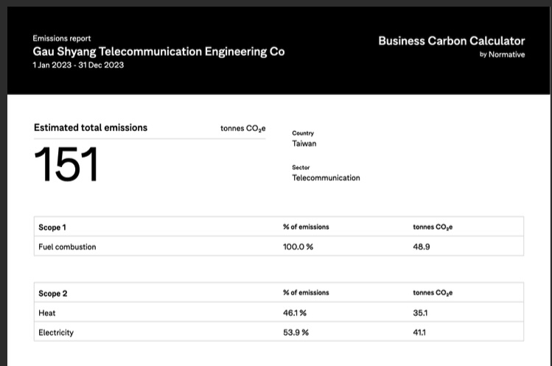
Map Emissions Emission mapping by Gau Shyang Telecom
Gau Shyang
2
高祥電信
碳排放計算報告 SME Climate Hub
Scope 1 Direct - Fuel combustion (燃料燃燒),
32.3% (48.9 ton CO2e)
Company vehicles (出車工作) : 22.3%
Business travel（商務旅行) : 10.0 %
Scope 2 Indirect - Electricity (電力),
50.5% (76.2 ton CO2e)
Company facilities (照明、冷氣、暖氣) : 40.0%
Energy related activities (電腦、列印、影印、傳真) : 10.5%
Note : 本公司只有設備裝機工程服務，並無製造工廠，所以只計算Scope 1 &2

Slide 4


Reduction Plan
Gau Shyang
高祥電信
3
Scope 1 – Fuel Combustion (48.9 ton)
Strategy | Action & Measurement | Y2024-Y2030 Annual Target | Y2030 Target | Y2031-Y2050 Annual Target | Y2050 Target
降低燃油消耗、減少待速時間，使用新能源汽車 | 每年採購(1-2)台電動車,從油耗最多的車輛進行更換,公務出差盡可能使用公共交通工具. | ~1.86% reduction/Year (Reducing ~2.81 ton CO2e/Year) | ~11.16% reduction (Reducing ~16.9 ton CO2e) | ~0.56% reduction/Year (Reducing ~0.84 ton CO2e/Year) | (Accumulated) ~22.32% reduction (Reducing ~33.7 ton CO2e)
減少外出會議，使用線上會議方式 | 採用線上會議,減少外出計畫全部(100%). | ~0.43% reduction/Year (Reducing ~0.65 ton CO2e/Year) | ~2.59% reduction (Reducing ~3.9 ton CO2e) | ~0.13% reduction/Year (Reducing ~0.20 ton CO2e/Year) | (Accumulated) ~5.17% reduction (Reduce ~7.8 ton CO2e)
商務旅行減少使用燃油車輛 | 宣導多搭乘大眾交通工具,計畫5年內至少有(30％) | ~0.40% reduction/Year (Reducing ~0.61 ton CO2e/Year) | ~2.43% reduction (Reducing ~3.7 ton CO2e) | ~0.12% reduction/Year (Reduce ~0.18 ton CO2e/Year) | (Accumulated) ~4.86% reduction (Reduce ~7.4 ton CO2e)

Slide 5
Reduction Plan
Gau Shyang
高祥電信
3
Scope 2 – Electricity (76.3 ton)
Strategy | Action & Measurement | Y2024-Y2030 Annual Target | Y2030 Target | Y2031-Y2050 Annual Target | Y2050 Target
降低辦公室電力消耗，使用節能燈管、空調溫度設定27度 | 辦公室燈具計畫5年內全部更換為節能燈具. (每年更換20%) | ~3.32% reduction/Year (Reducing ~5.02 ton CO2e/Year) | ~19.93% reduction (Reducing ~30.1 ton CO2e) | ~1.00% reduction/Year (Reducing ~1.51 ton CO2e/Year) | (Accumulated) ~39.87% reduction (Reducing ~60.2 ton CO2e)
推行無紙化及使用回收紙列印 | 公司請款及文件簽核全面(100%)採用數位簽章,以減少紙張浪費 | ~0.67% reduction/Year (Reducing ~1.02 ton CO2e/Year) | ~4.04% reduction (Reducing ~6.1 ton CO2e) | ~0.20% reduction/Year (Reducing ~0.31 ton CO2e/Year) | (Accumulated) ~8.08% reduction (Reduce ~12.2 ton CO2e)
宣傳教育，提高節能減排意識 | 每年(Bi-Annually)做一次宣傳教育並檢討前一年的排碳報告 | ~0.21% reduction/Year (Reducing ~0.32 ton CO2e/Year) | ~1.26% reduction (Reducing ~1.9 ton CO2e) | ~0.06% reduction/Year (Reduce ~0.10 ton CO2e/Year) | (Accumulated) ~2.52% reduction (Reduce ~3.8 ton CO2e)

Slide 6
Reduction Plan
Gau Shyang
高祥電信
3
Scope 3 – Supply chain (26 ton)
Strategy | Action & Measurement | Y2024-Y2030 Annual Target | Y2030 Target | Y2031-Y2050 Annual Target | Y2050 Target
貨運運輸車輛減少使用燃油車 | 物料運送時車輛,盡可能派遣非燃油車輛,及減少運輸次數 | ~1.36% reduction/Year (Reducing ~2.06 ton CO2e/Year) | ~8.17% reduction (Reducing ~12.4 ton CO2e) | ~0.41% reduction/Year (Reducing ~0.62 ton CO2e/Year) | (Accumulated) ~16.34% reduction (Reducing ~24.8 ton CO2e)
倉儲物流用具物品使用環保材質 | 倉儲辦公、物流包裝用具,優先採用非塑化材質物品,及可回收利用材質 | ~0.07% reduction/Year (Reducing ~0.11 ton CO2e/Year) | ~0.43% reduction (Reducing ~0.7 ton CO2e) | ~0.02% reduction/Year (Reducing ~0.03 ton CO2e/Year) | (Accumulated) ~0.86% reduction (Reduce ~1.4 ton CO2e)

Slide 7
Public Target
Gau Shyang
高祥電信
4
Gau Shyang Telecom publishes their target in line with the 1,5°C Climate Ambition
The public commitment is published on the company’s own website, annual report, or on SME Climate Hub
詳閱請蒞臨公司網址
https://gaushyang.netlify.app/#
高祥電信工程(股)公司
承諾：以實現1.5℃為企業目標，設定符合SBTi 1.5°C淨零減量目標
Company will halve emissions by 2030 and reach Net-Zero by 2050
2024至2030年每年減量目標8%、2030至2050年每年減量目標2.6%，於2050年達到淨零

Slide 8
電信工程股份有限公司
END
10 Oct, 2024

